Slide 1

2GA3 Tutorial #12
DATE: December 6th, 2021
TA: Jatin Chowdhary

Slide 2
Last Tutorial
There are no tutorials on Friday
The last-last tutorial is tomorrow, Tuesday
  It’s also a review tutorial
Final exam is December 20th, 2021
  Literally 2 weeks till D-Day
Today’s content is good practice for the final exam
  Make sure you review it, at least once

Slide 3
Exam Review
Tutorial 2, Q3 (2.7)
Tutorial 3, Q1 (2.13)
Tutorial 4, Q2 (2.31)
Tutorial 7, Q4 (4.5)
Tutorial 12, Q5
  This is the only new content in today’s tutorial
    Everything else is review
      We will start off with this

Slide 4
Tutorial 12, Q5
Question: A machine has a 32-bit virtual address space and a 16KB page size. It has 1GB of physical memory. How many pages does a process have? How many bytes are needed for a page table, assuming 4 control bits and that disk addresses are stored elsewhere?
Precursor:
  Next slide

Slide 5
Tutorial 12, Q5
Precursor:
  The virtual address space is 32-bits
    This is the size of the virtual memory
  The page size is 16KB
    KB = Kilobytes
  The size of the physical memory is 1 GB
    GB = Gigabyte
  The stuff in the virtual address space maps to physical meory

Slide 6
Tutorial 12, Q5
Answer:
  To calculate the pages per process, or the number of pages, we need to divide the page size by the size of the virtual memory
    i.e. Number Of Pages = Virtual Memory Size ÷ Page Size
  But wait, there’s a problem
    The page size is given in KB, and we need B
      KB = Kilobytes
      B = Bytes

Slide 7
Tutorial 12, Q5
Answer:
  So, we convert 16 KB to ??? B
    It’s a simple calculation
      Page size (Bytes) = 16 × 2¹⁰
      Page size (Bytes) = 2⁴ × 2¹⁰
      Page size (Bytes) = 2¹⁰ ⁺ ⁴
      Page size (Bytes) = 2¹⁴
  Finally, we divide the new page size by the virtual memory size
    Next slide

Slide 8
Tutorial 12, Q5
Answer:
  Number Of Pages = Virtual Memory Size ÷ Page Size
  Number Of Pages = 2³² ÷ 2¹⁴
  Number Of Pages = 2^{32 – 14}
  Number Of Pages = 2¹⁸ = 262144 = 256K
Therefore, the number of pages per process is 2¹⁸

Slide 9
Questions?
Comments?
Concerns?

Slide 10
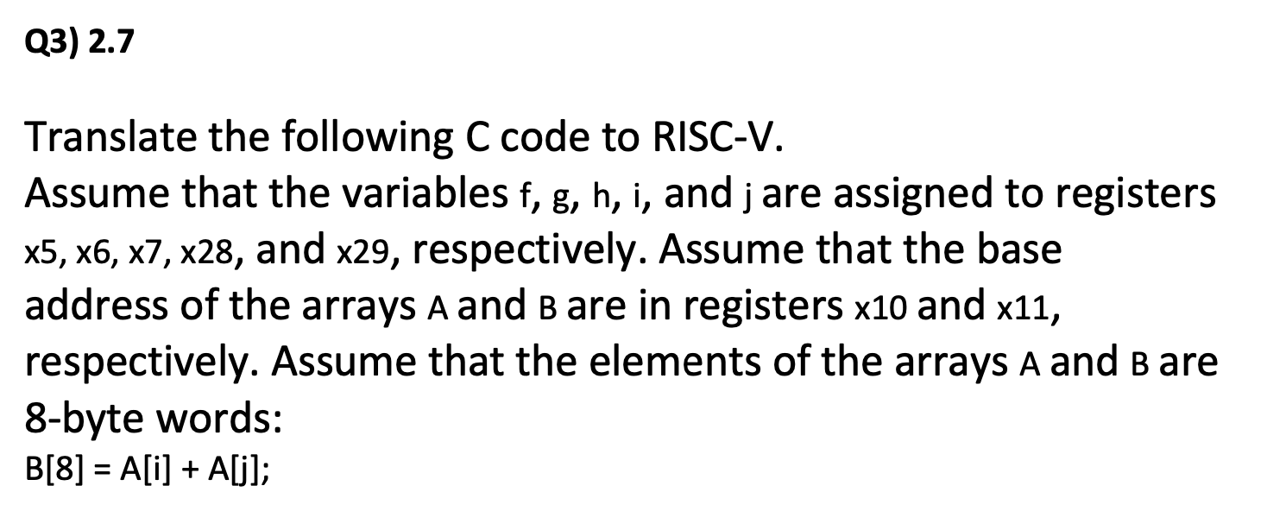
Tutorial 2, Q3 (2.7)
Question: X
Answer: X

Slide 11
Questions?
Comments?
Concerns?

Slide 12
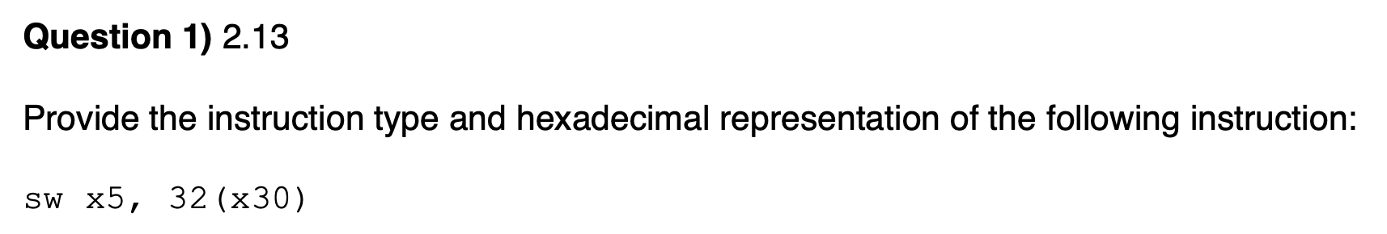
Tutorial 3, Q1 (2.13)
Question: X
Answer: X

Slide 13
THE
END

Slide 14

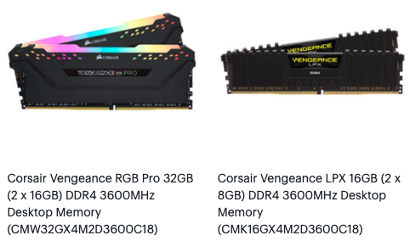
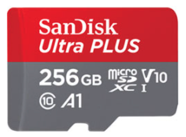
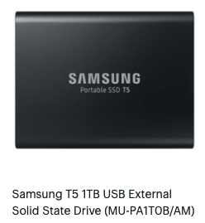
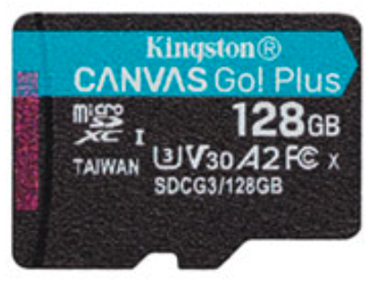
Clarification
Bytes Vs. Bits
  Bytes are represented with a BIG B
    i.e. 4GB, 8GB, 16GB, etc.
  Bits are represented with a small b
    i.e. 150Mbps, 100 Mbps, 1024 Gb, etc.

Slide 15
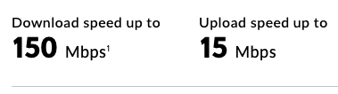
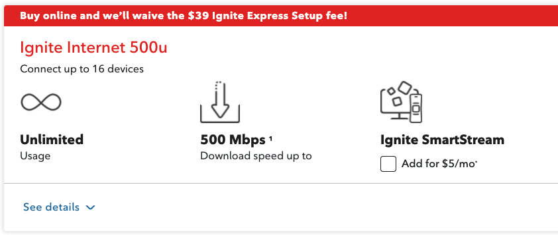
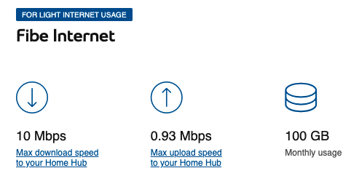
Clarification
Bytes Vs. Bits
  Bytes are represented with a BIG B
    i.e. 4GB, 8GB, 16GB, etc.
  Bits are represented with a small b
    i.e. 150Mbps, 100 Mbps, 1024 Gb, etc.

Slide 16
THE END

